Slide 1


Bærekraftig porttelefon og adgangskontrollsystem
for en optimalisert brukeropplevelse
både for næring og bolig

Slide 2
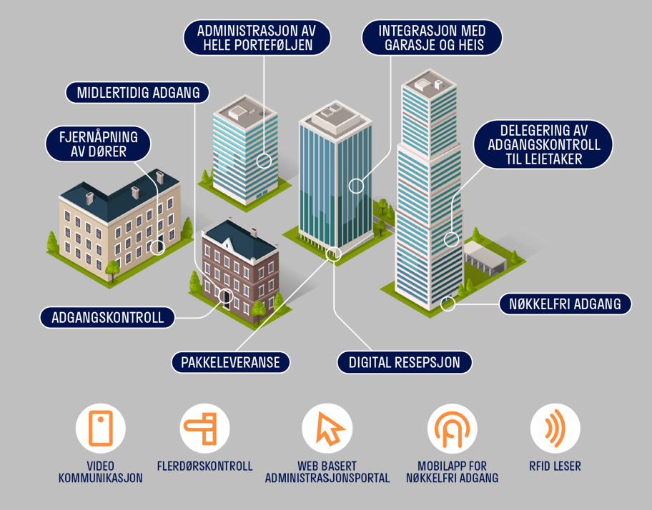
Et enklere, tryggere og smartere bygg
Notes:
When you start a company, or design a product, you do so to solve a problem. But the reality now is that we all face the same big environmental problem. This means that now the smaller problems we try to solve must also contribute to solving or reducing our impact on this big problem.
So when it comes to Defigo, we do access control for both commercial and residential properties.

Slide 3
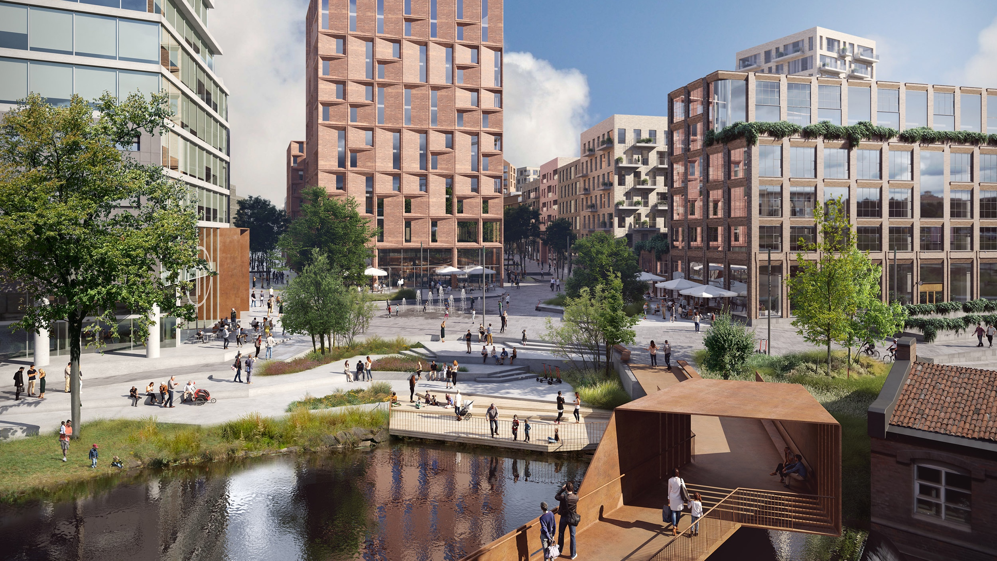
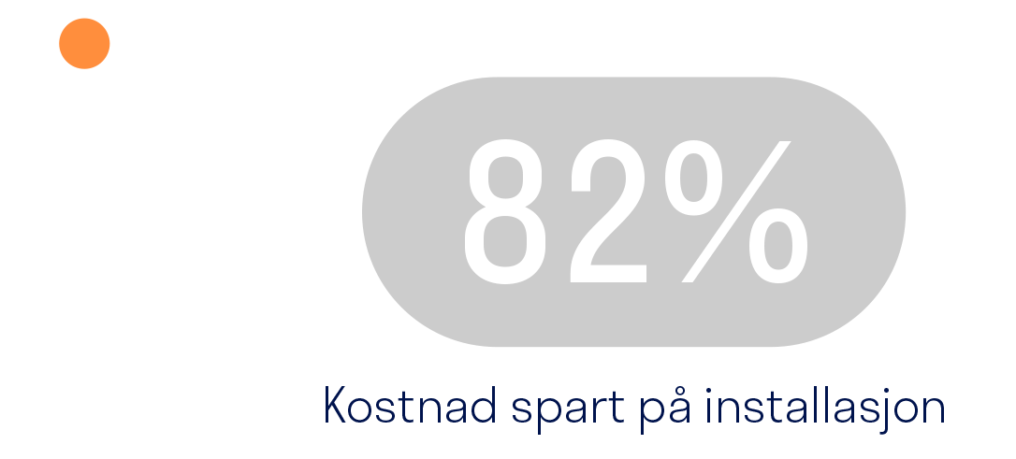
Reduser byggets C02 utslipp med minst 0,5 tonn pr år
Notes:
But we also do access control for developers that want to save up to 5 tons of CO2 emissions per building

Slide 4
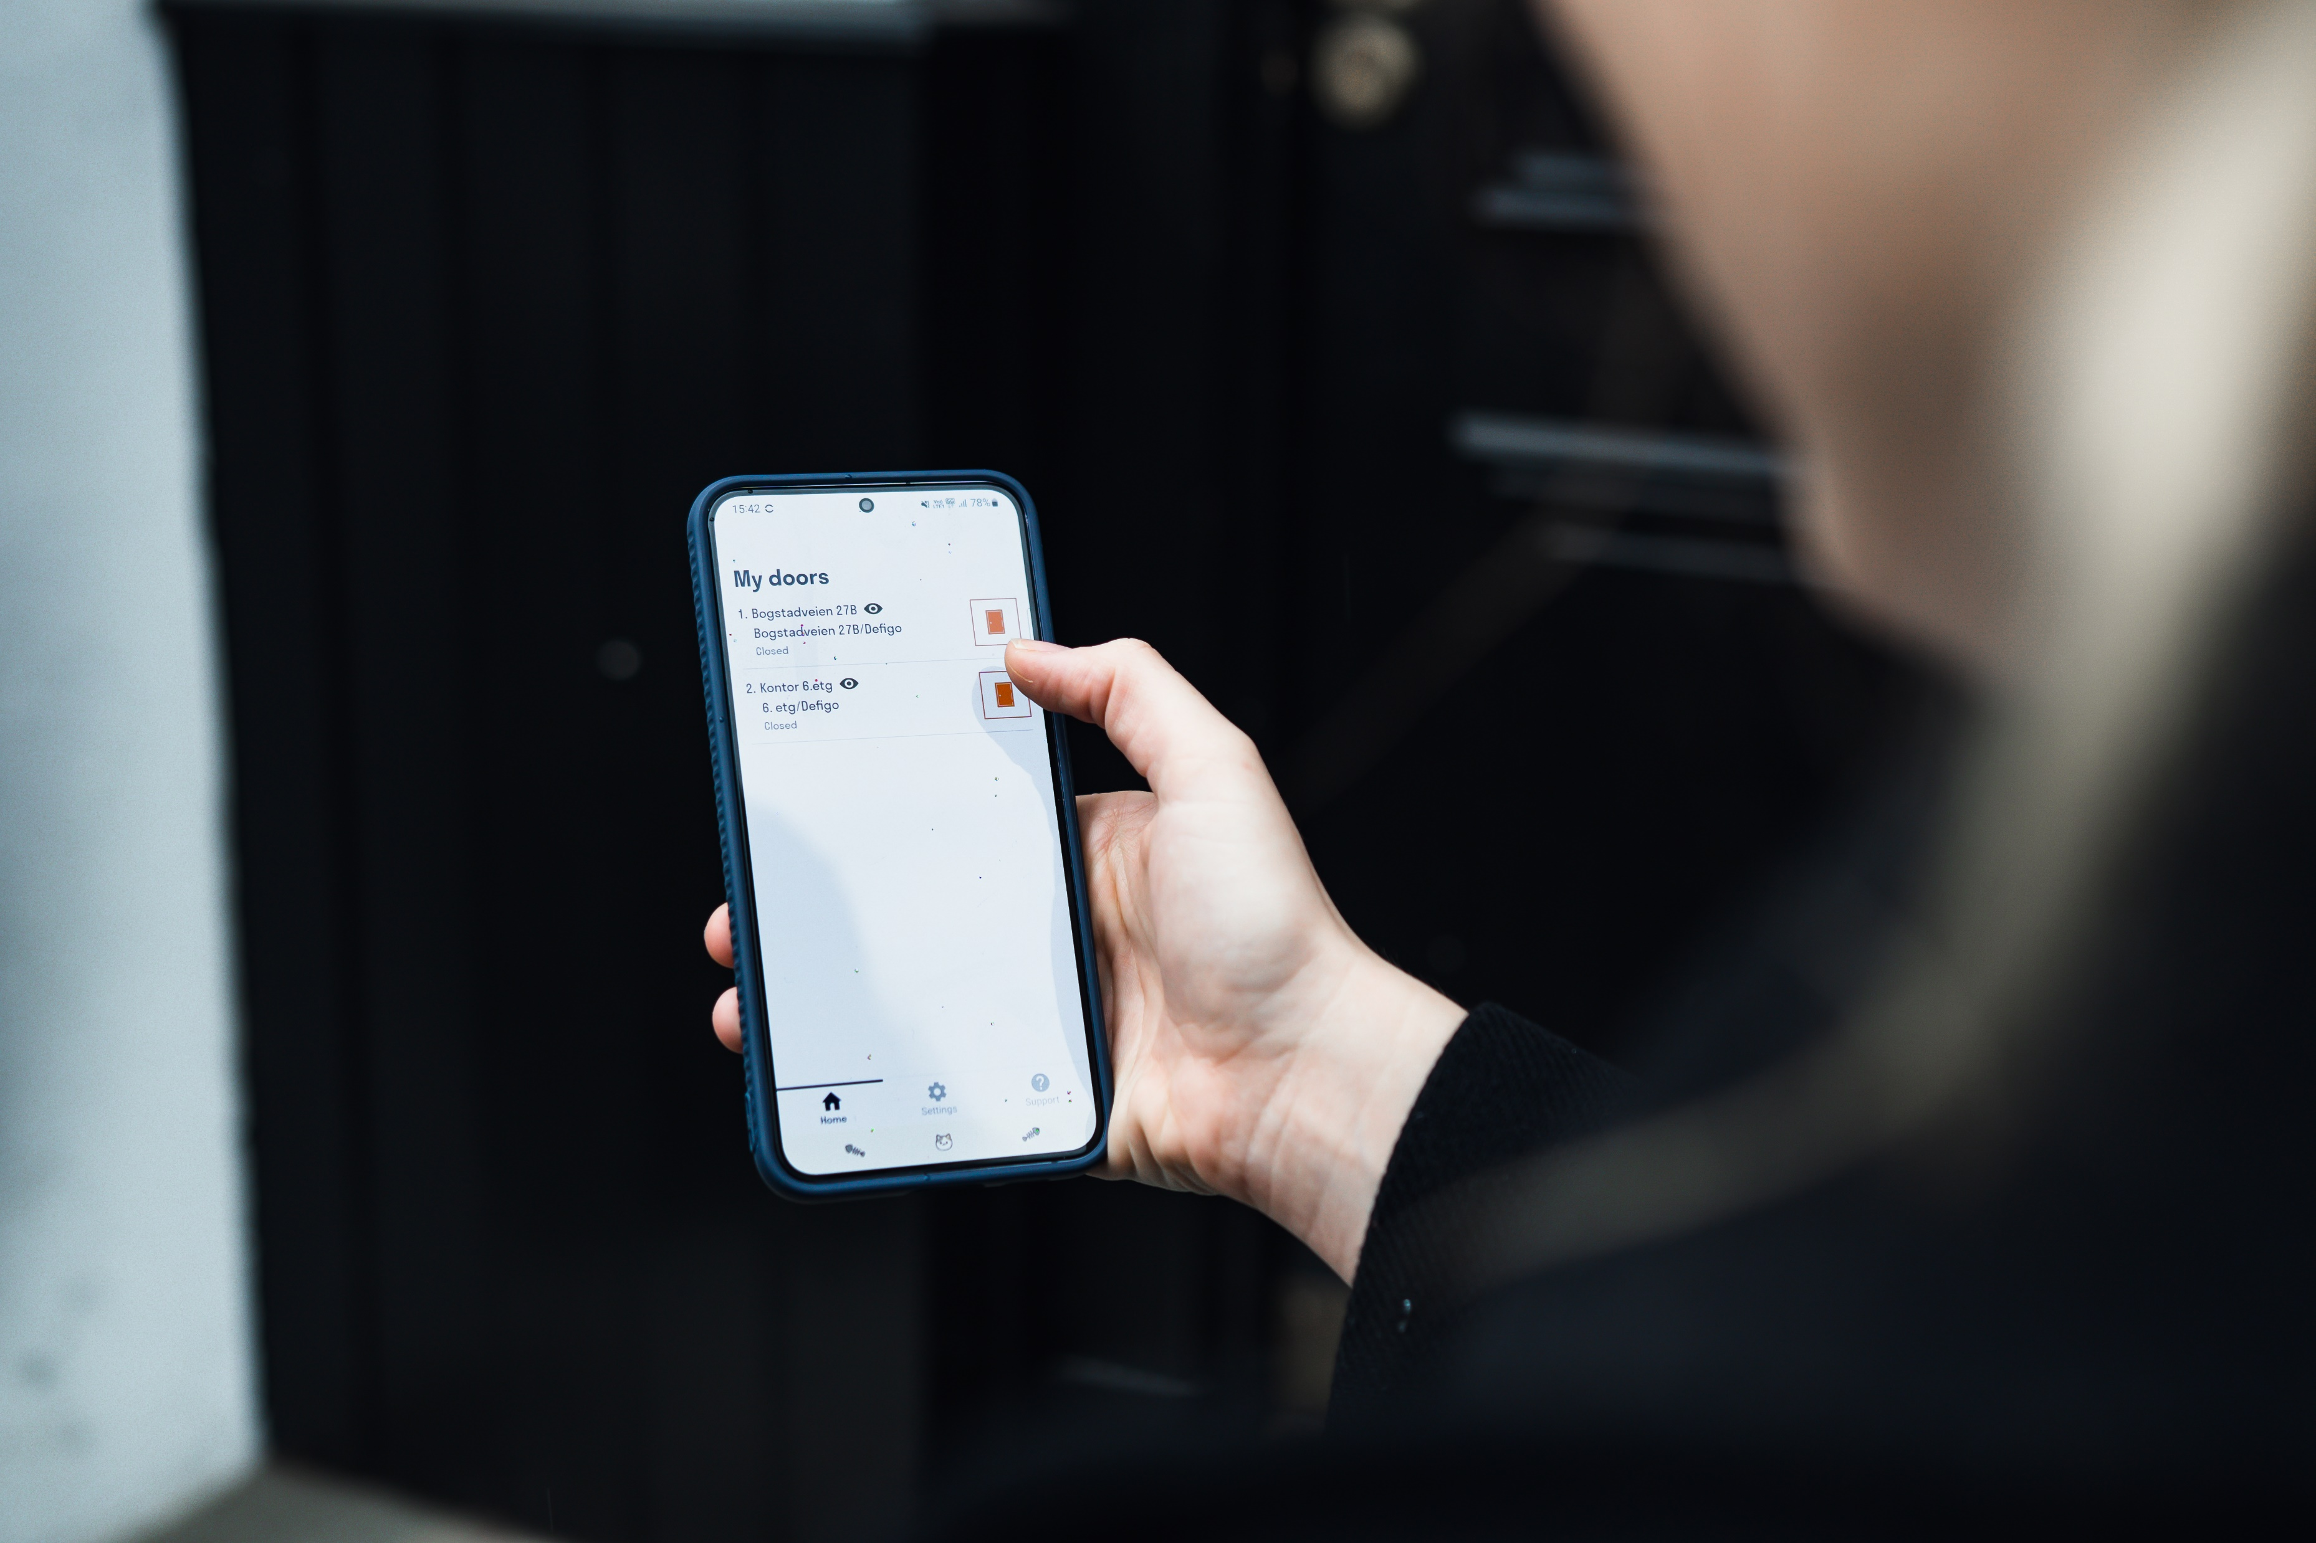
Nøkkelfri adgang
Notes:
And we also do access control for end users who don’t want to make a new key every few months because they lost it.

Slide 5
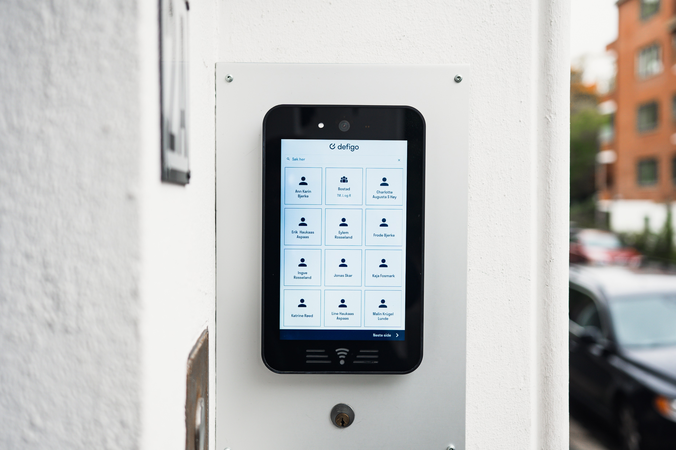
Brukervennlig og tilpassningsdyktig porttelefon
Notes:
And we also do access control for property administrators that are sick of those tiny bits of paper taped on ancient doorbell systems that let unauthorized people into the building.

Slide 6
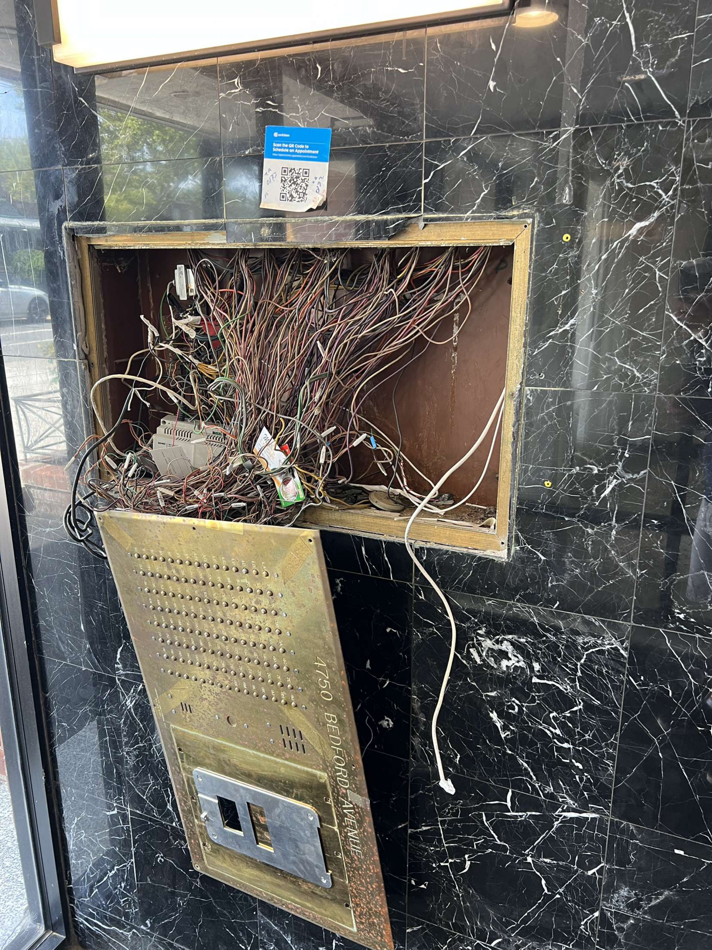
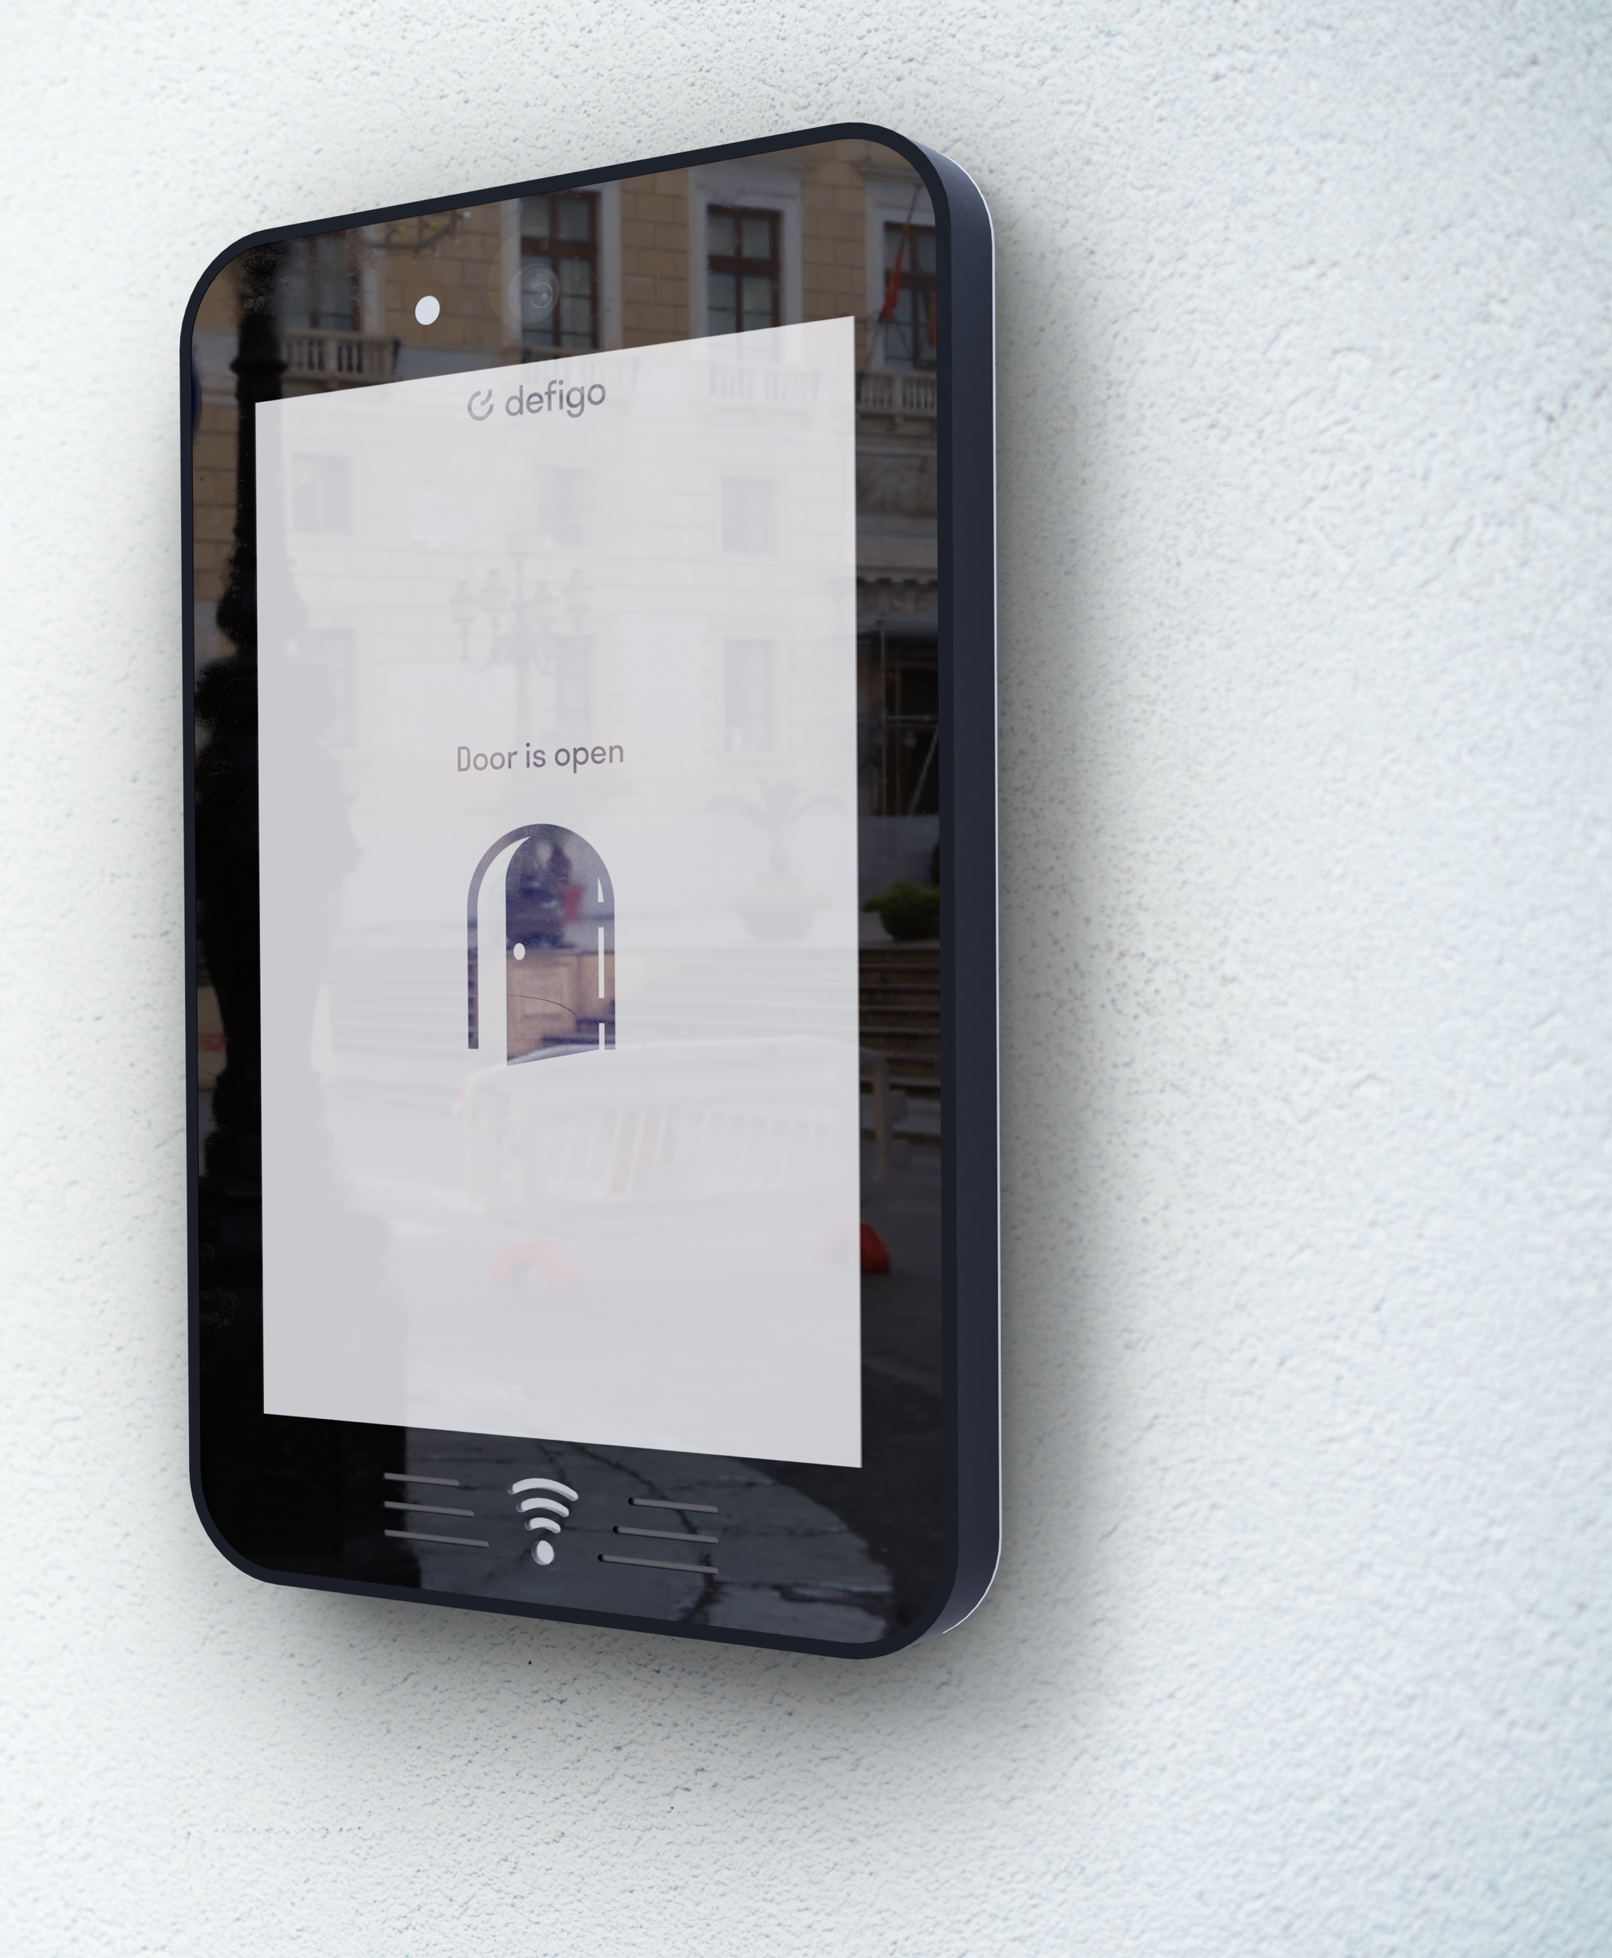
Minimalt med kabling
Notes:
Our Intercoms are touch screen, durable for all weather and really, really good looking. They also have minimal wiring, saving property developers tens of thousands of kilometres of copper wiring…a limited natural resource.

Slide 7
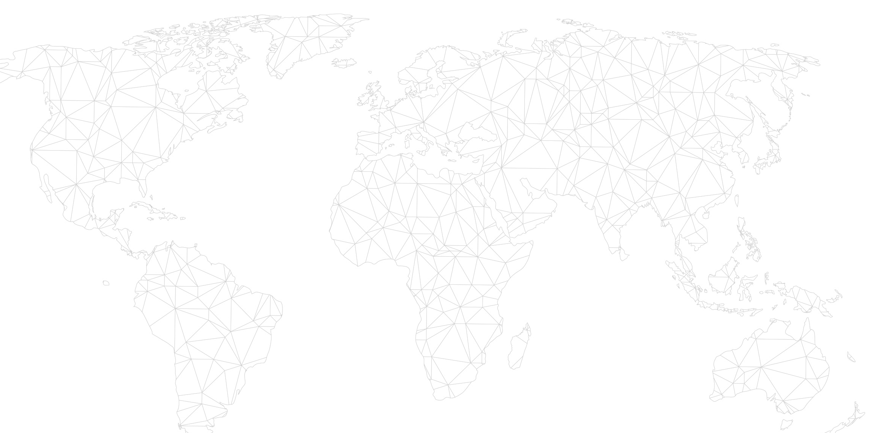


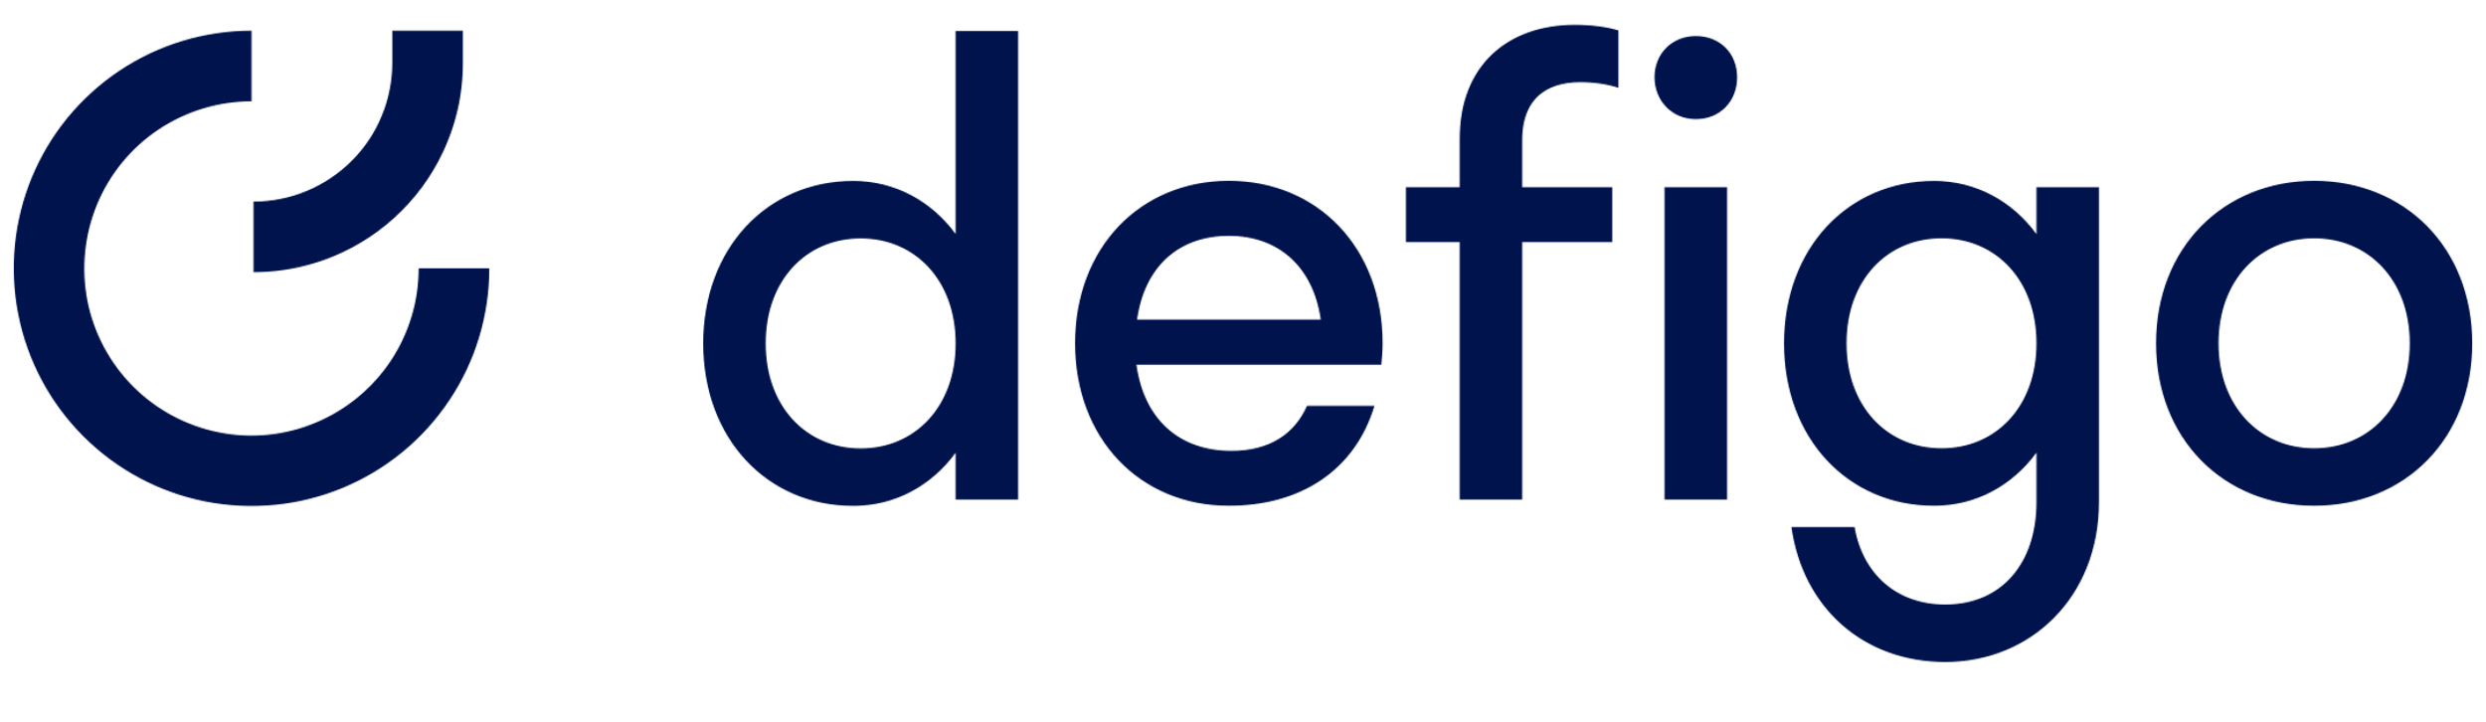
Spar kostnad ved å redusere kablingen
"Ved å velge Defigo fremfor mer tradisjonell adgangskontroll sparer vi 82 % i installasjonskostnader og vi kan spare 10 200 kilometer med kabling på et av våre største prosjekter – det er kobberkabling hele veien fra Oslo til Jakarta!»
Terje Wathne, Teknisk eiendomssjef,
Mustad Eiendom

Slide 8

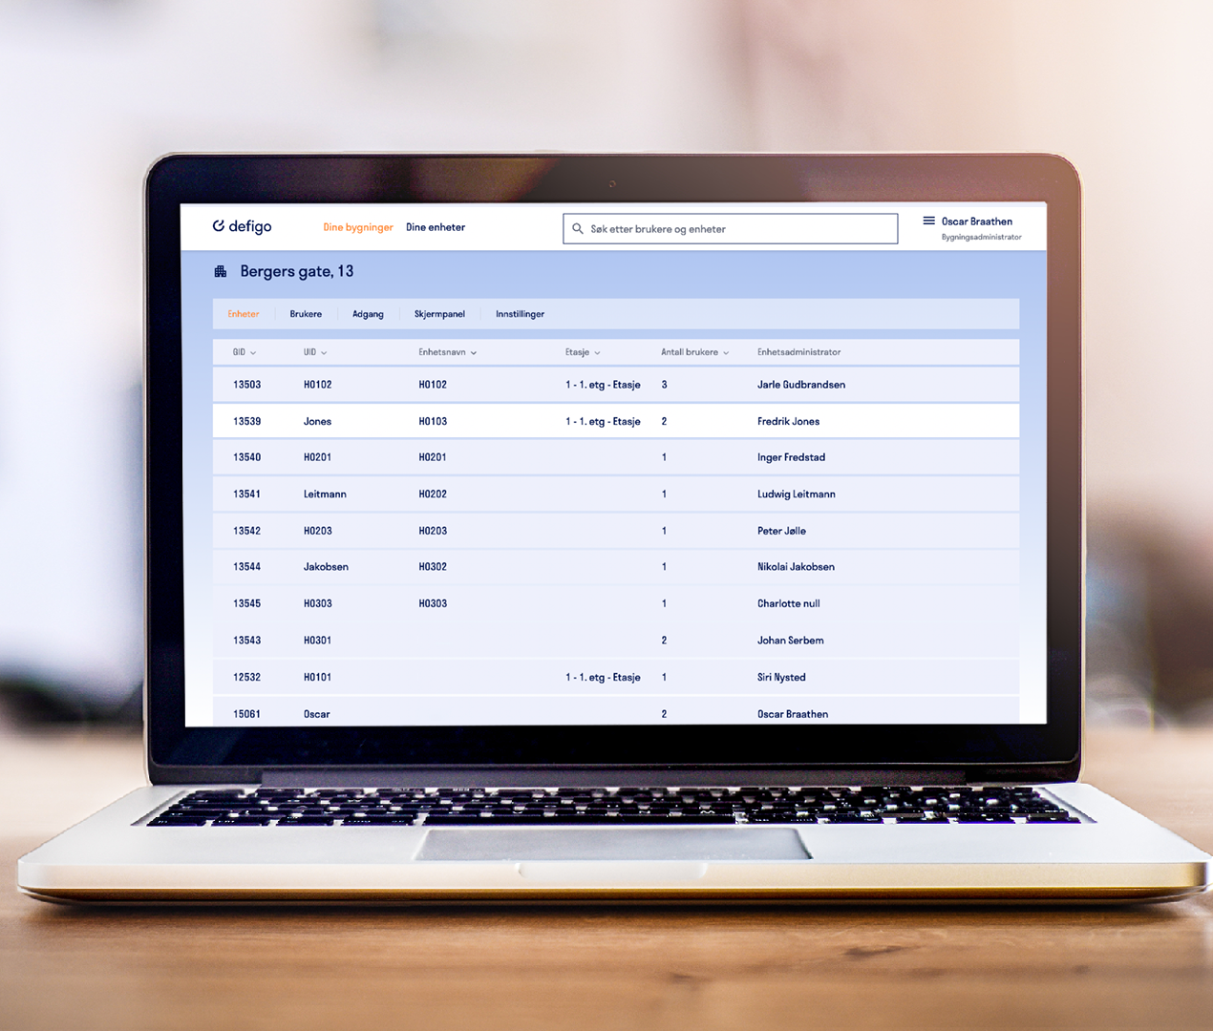

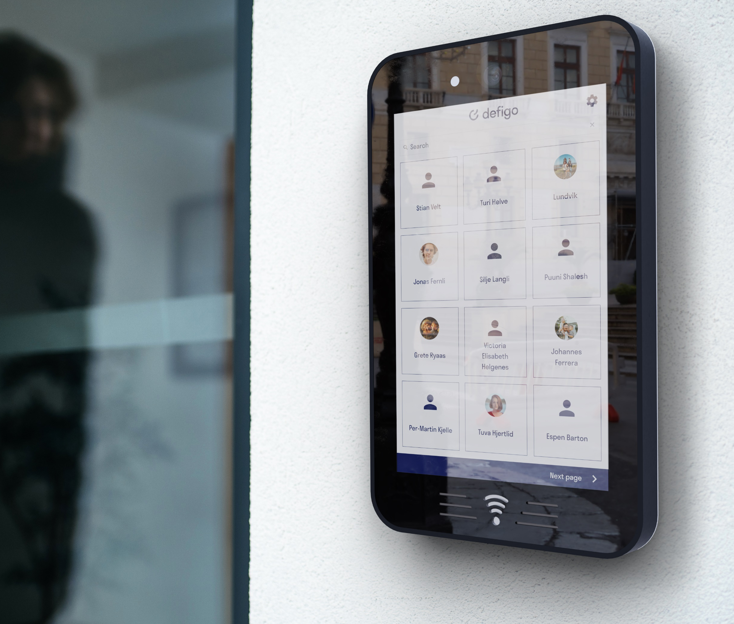
SIMPLER. SAFER. SMARTER.
Designet og utviklet i Norge, selges som en tjeneste
Web-basert administrasjonsportal
Nøkkelfri adgang med
mobilapplikasjon og brikker
Digital porttelefon med touchscreen, kamera og
RFID leser for brikker
Notes:
We are proudly a keyless system. Tenants can enter their building simply using the Defigo app on their phone.
We also have subscription business model, which means building administrators will invest in Defigo, and then never have to change again.
We guarantee software and hardware updates, reusing materials from previous generations to minimise the creation of new materials making the whole Defigo system future-proof.

Slide 9

SIMPLER. SAFER. SMARTER.
Tusen takk

