Slide 1
Notes:
ClevAir harvest data from IoT devices and BMS in buildings, real time, 24/7. This data is enriched with weather data and used by our software to optimize HVAC, and typically reduce the energy consumption for HVAC by 10 to 40%
https://worldgbc.org/news-media/WorldGBC-embodied-carbon-report-published - Together, building and construction are responsible for 39% of all carbon emissions in the world[1], with operational emissions (from energy used to heat, cool and light buildings) accounting for 28%. The remaining 11% comes from embodied carbon emissions, or ‘upfront’ carbon that is associated with materials and construction processes throughout the whole building lifecycle. WorldGBC’s vision to fully decarbonise the sector requires eliminating both operational and embodied carbon emissions.

Slide 2
What can we do about it?
ClevAir is a SaaS based tool for managing HVAC in commercial real estate
ClevAir reduces energy consumption and CO₂ emissions, while delivering air quality according to the ASHRAE* standard
ClevAir also provides insights, dashboards and data to help create reports according to the EU-taxonomy
W I N N E R
Winner
Top 100 European startups
“start up of the year”
nomination
Top 5 start ups
Winner
* American Society of Heating, Refrigerating and Air-Conditioning Engineers
Notes:
ClevAir is a SaaS based tool for managing HVAC (Heating, Ventilation Air Condition) in commercial real estate
ClevAir reduces energy consumption while delivering air quality according to ASHRAE standard. ClevAir also provides valuable insights on energy consumption and air quality that is used by our customers to manage their building portfolio in a more energy efficient way
ClevAir also provides data to help provide reports according to the EU-taxonomy

Slide 3
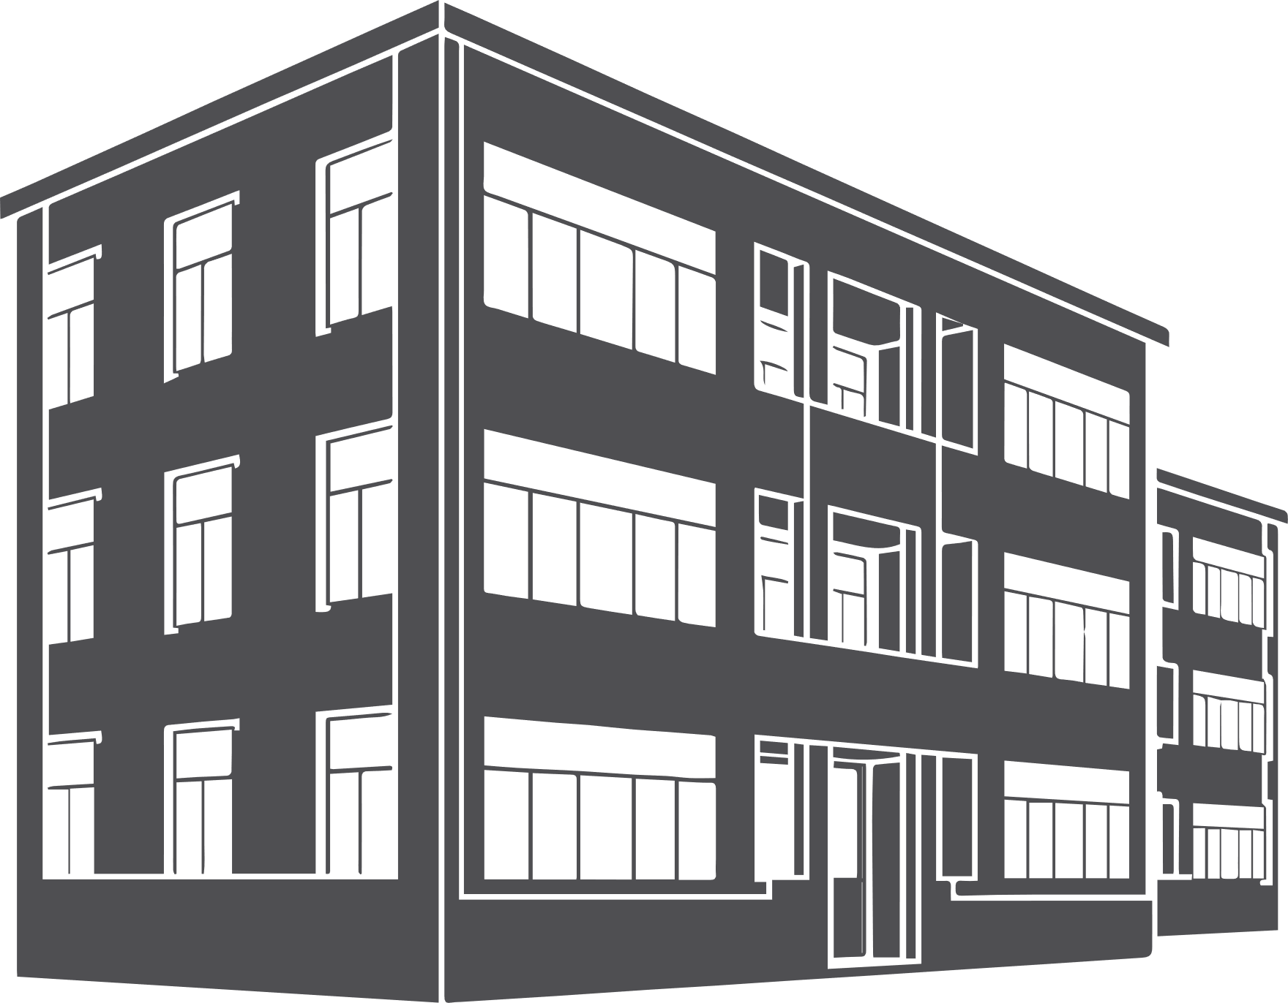
This is how ClevAir works
Weather data/ energy tariffs etc
Machine Learning
Sensor and
BMS-data
Optimization
Data lake
Building HVAC
Harvest data from IoT devices and BMS in real time, 24/7
Typically reduces the energy consumption by up to 25%
Notes:
ClevAir harvest data from IoT devices and BMS in buildings, real time, 24/7. This data is enriched with weather data and used by our software to optimize HVAC, and typically reduce the energy consumption for HVAC by 10 to 40%
https://worldgbc.org/news-media/WorldGBC-embodied-carbon-report-published - Together, building and construction are responsible for 39% of all carbon emissions in the world[1], with operational emissions (from energy used to heat, cool and light buildings) accounting for 28%. The remaining 11% comes from embodied carbon emissions, or ‘upfront’ carbon that is associated with materials and construction processes throughout the whole building lifecycle. WorldGBC’s vision to fully decarbonise the sector requires eliminating both operational and embodied carbon emissions.

Slide 4
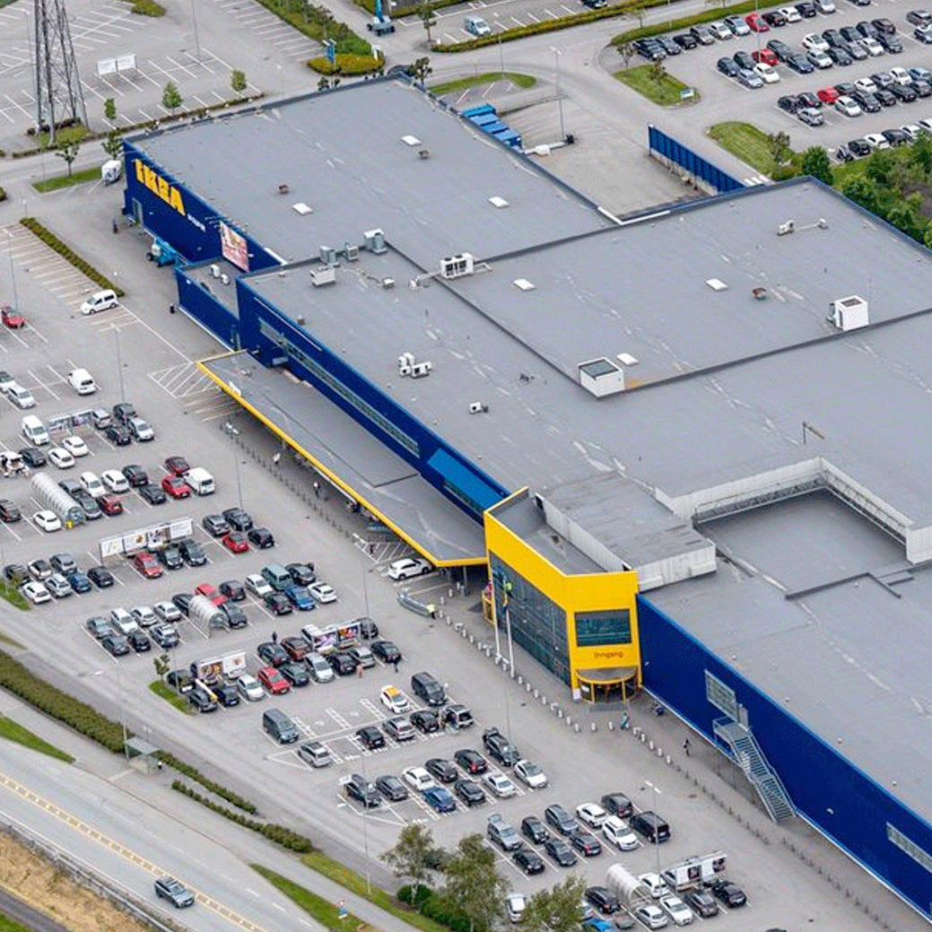
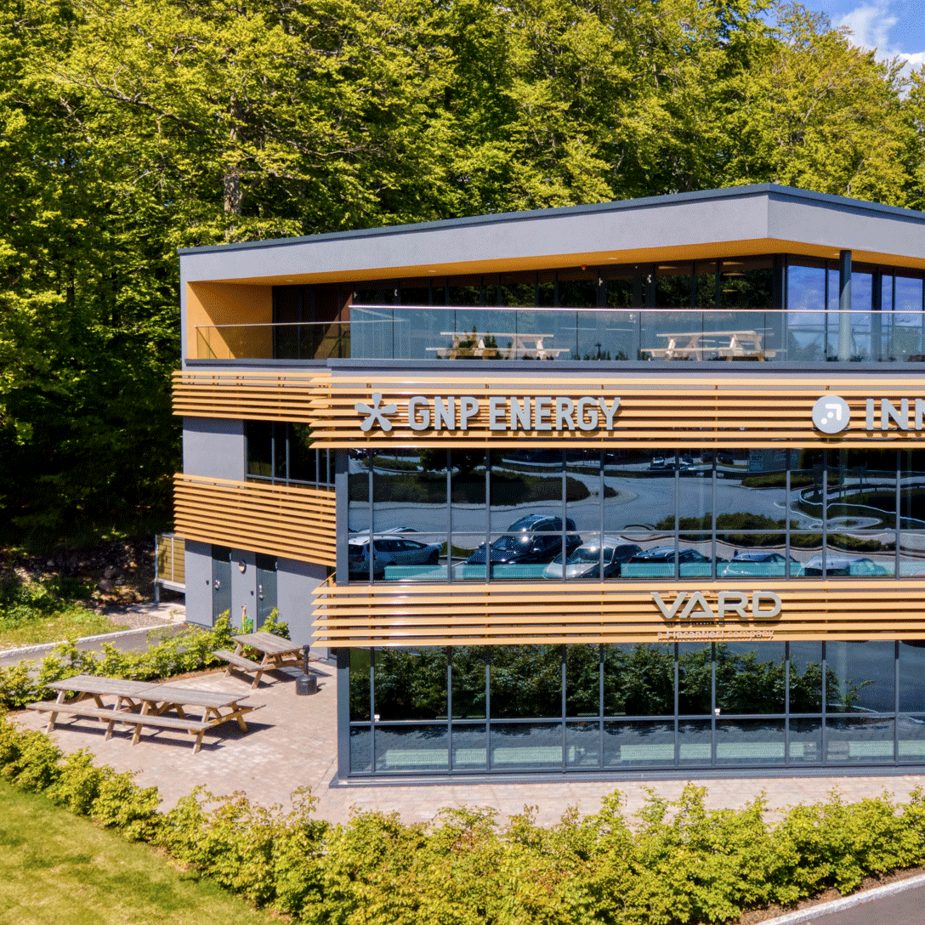
This is our value proposition
Benefits
Savings from some real estate customers
Financial benefits
Reduce energy consumption
Cut effect peaks
Improved energy rating increases the value of the building
Environmental benefits
Reduce CO₂ emissions
Simplify EU Taxonomy reporting
Air quality
Confirm and optimize the air quality
IKEA Forus
GNP Areal
Køhler Eiendom
-21%
-32%
-29%
ClevAir Company Presentation 2022
Notes:
ClevAir is a SaaS based tool for managing HVAC (Heating, Ventilation Air Condition) in commercial real estate
ClevAir reduces energy consumption while delivering air quality according to ASHRAE standard. ClevAir also provides valuable insights on energy consumption and air quality that is used by our customers to manage their building portfolio in a more energy efficient way
ClevAir also provides data to help provide reports according to the EU-taxonomy
GNP areal: Reduced their energy consumption by 97.000 kWh (31,9%) in 15 months, while at the same time reducing draft and unbalanced temperatures throughout the building
IKEA: Reduced their energy consumption by 1.150.000 kWh (18.5%) in 2 years
Koppholen: Reduced their energy consumption by 80.000 kWh (30.4%) in 2 months, and experienced better air quality

Slide 5
Savings potential:
Example
Building size
10.000 m²
Energy consumption
180 kWh per m² per year
Price per kWh
NOK 2 per kWh
ClevAir savings on average
20%
ClevAir installation
NOK 100.000
ClevAir monthly fee
NOK 1 per m²
Savings: 360.000 kWh per year
CO₂ reduction: 145 tons per year
ROI: 5 months
Savings year 1: NOK 140.000
Savings year 2: NOK 240.000

